Slide 1
CONSTRUCTION INDUSTRY ROUND TABLE
Superpower to Success:
Leading People, Teams, and Yourself in Today’s Landscape

Slide 5
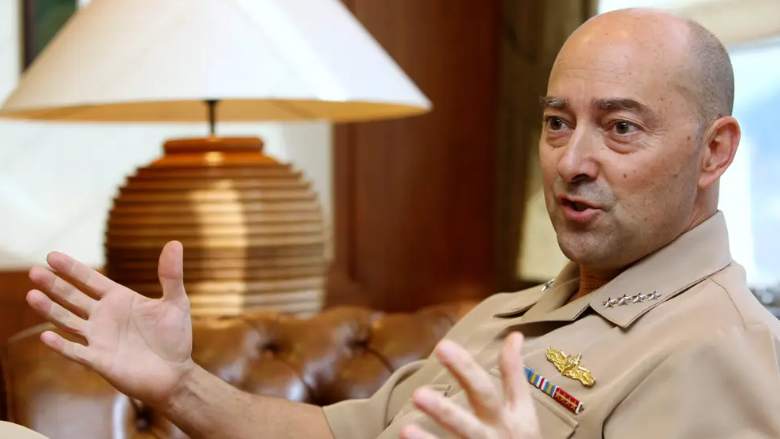

Slide 6
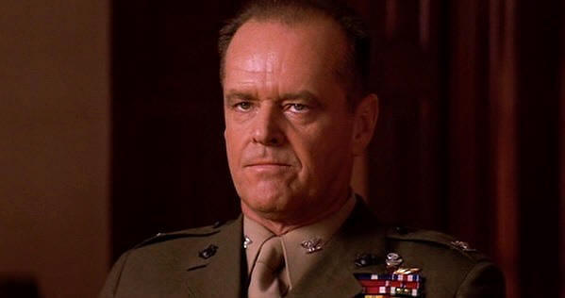

Slide 8
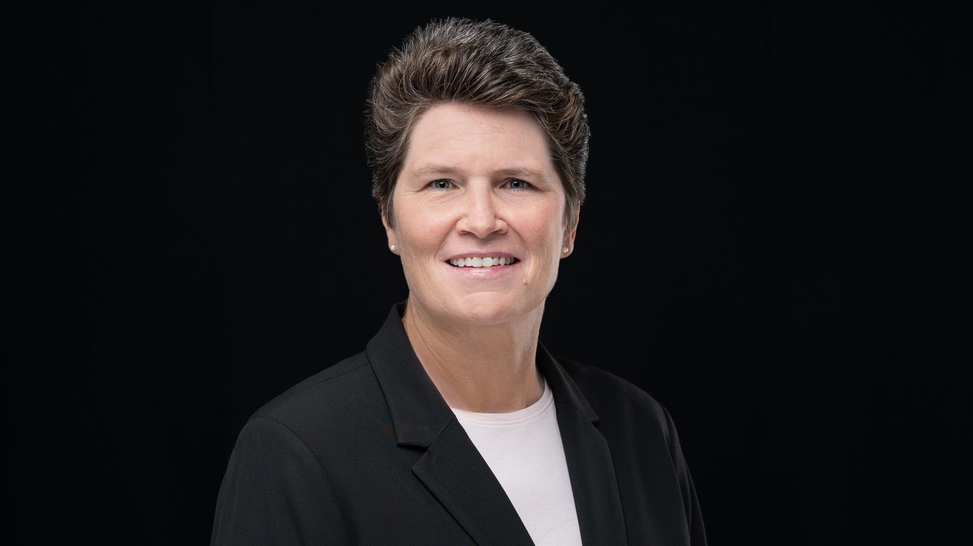

Slide 10
Vision
Flexibility
Humility
Self-Confidence
Self-Awareness
Curiosity
Empathy
Morality
Love of People

Slide 11
Vision
Flexibility
Humility
Self-Confidence
Self-Awareness
Curiosity
Empathy
Morality
Love of People

Slide 19
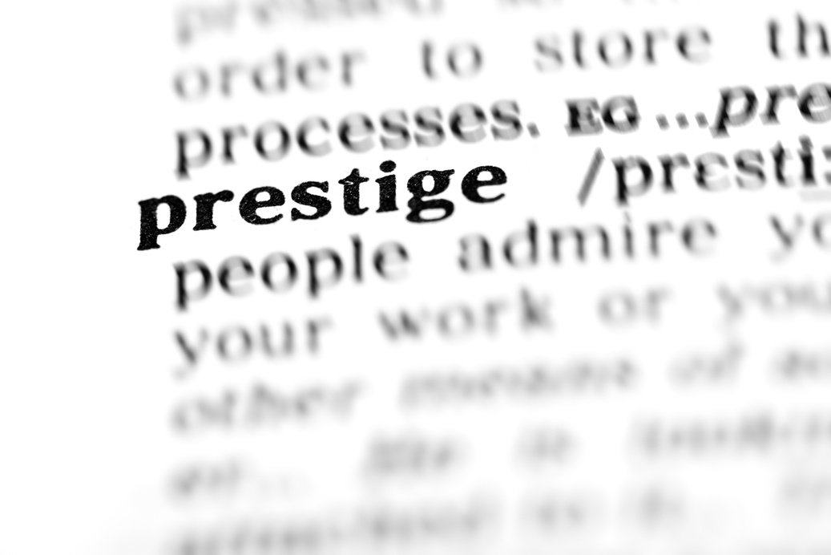
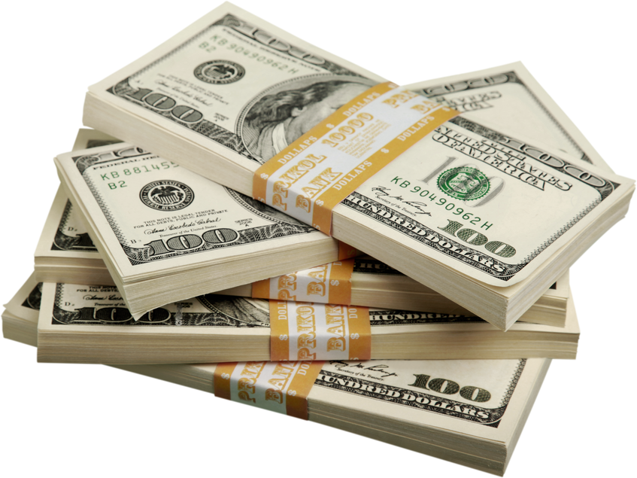

Slide 22
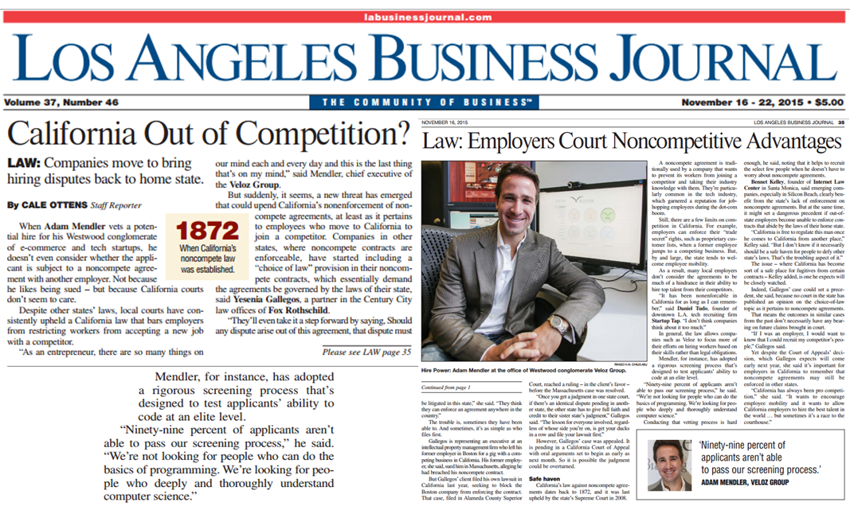

Slide 24
SKILL
SUPERPOWER

Slide 25
SKILL
WHAT YOU DO

Slide 26
SUPERPOWER
YOUR GIFT
THAT ALLOWS YOU TO
EXCEL AT WHAT YOU DO

Slide 27
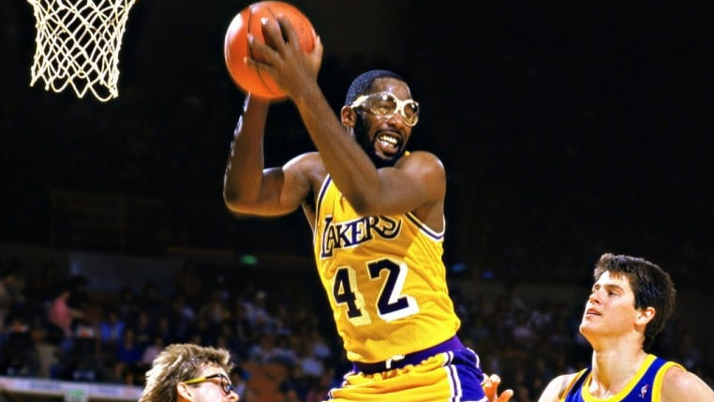

Slide 30
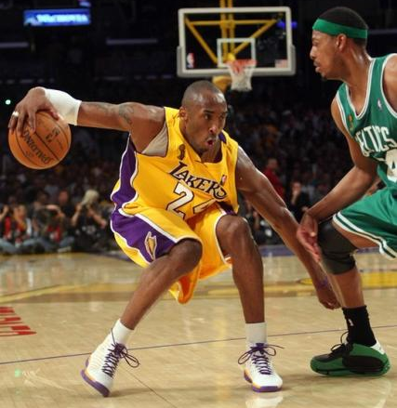

Slide 31
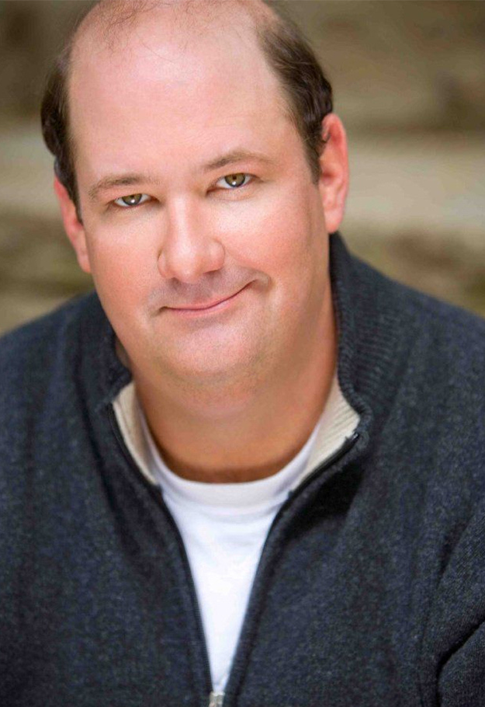

Slide 33
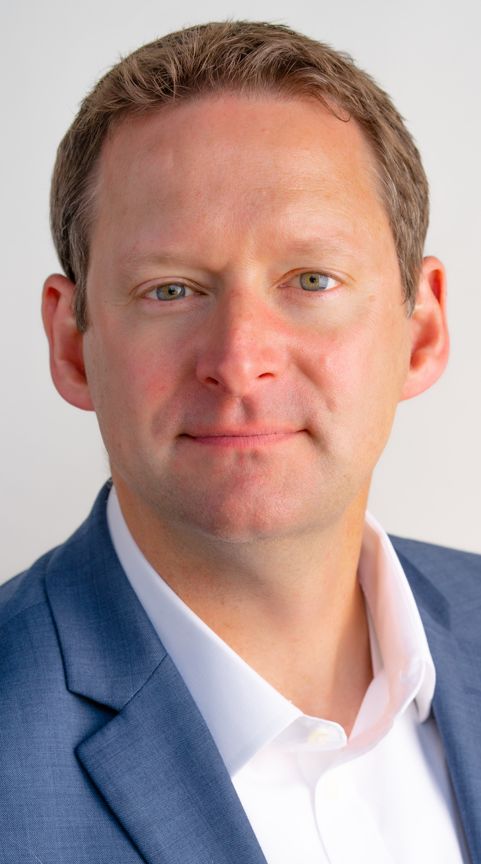
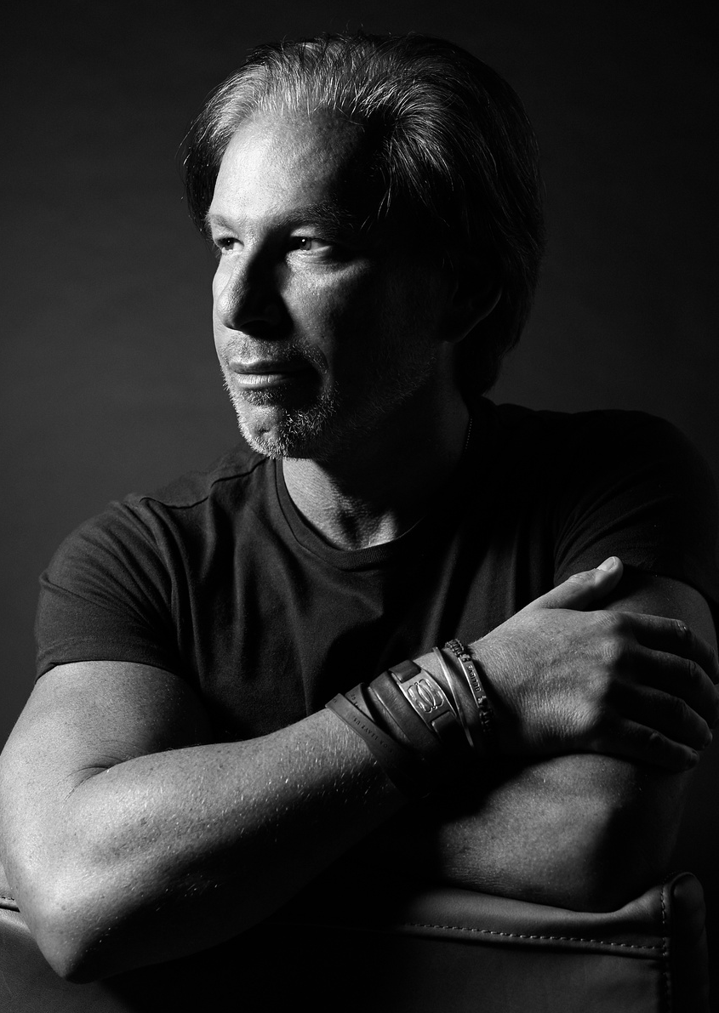

Slide 35
Identify a leader you admire.
What is their skill?
What is their superpower?
How does their superpower fuel their success?

Slide 37
DISCOVER
DEVELOP
DEPLOY

Slide 38
DISCOVER

Slide 41
What do you enjoy doing?

Slide 42
What comes easily to you?

Slide 43
What can you do all day
without getting bored?

Slide 44
What energizes you?

Slide 45
What do others appreciate in you?

Slide 47
DEVELOP

Slide 49
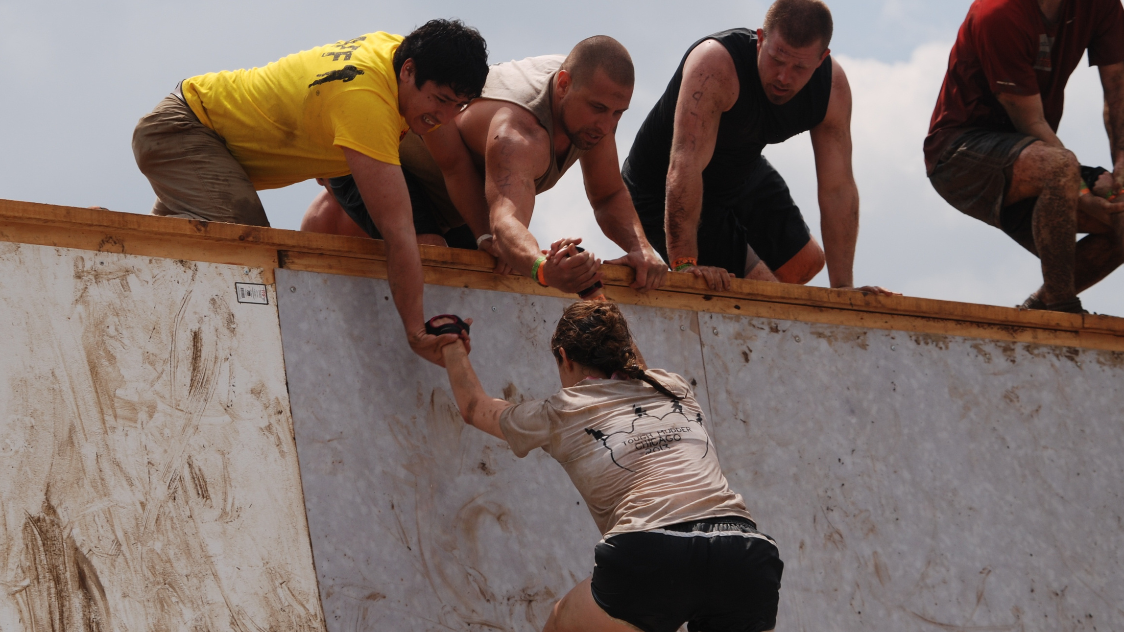

Slide 55
DEPLOY

Slide 56
Am I doing something that I love?
Am I doing something I am great at?
Am I making a positive impact?

Slide 57
SKILL
SUPERPOWER

Slide 59
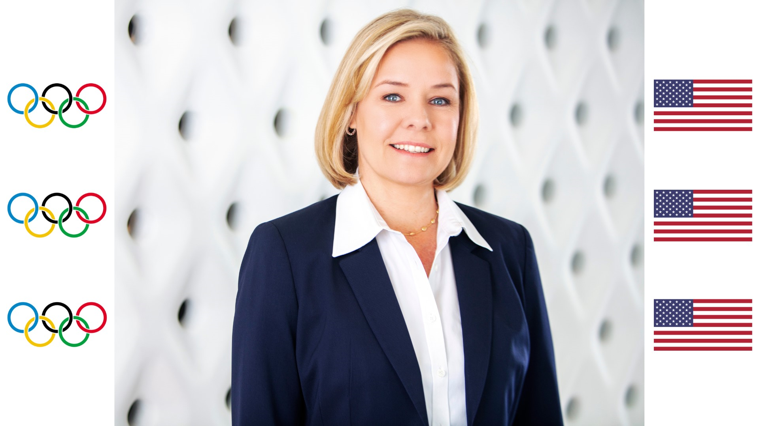

Slide 62
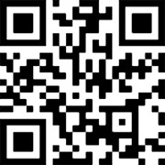
Mentorship Guide +
Feedback & Thoughts
1. Scan this QR code
2. Enter this code on the screen
MENTOR
Stay in touch!
adam@adammendler.com
@adammendler
or go to talk.ac/adam
adammendler

