Slide 1
October 2023
Improving Lives Through Construction Education
Boyd Worsham, NCCER President & CEO
Jennifer Wilkerson, NCCER VP – Innovation & Advancement

Slide 2
The National Center for Construction Education and Research, a not-for-profit construction education foundation
Est. 1996
Provide rigorous and relevant workforce development solutions that create opportunities for individual career advancement and support industry growth.
Mission
Vision
A qualified and successful workforce of diverse individuals whose lives were improved through construction education.

Slide 3
The National Center for Construction Education and Research, a not-for-profit construction education foundation
Est. 1996
Curricula & Assessments
Over 45 crafts and 25 construction-related areas of study
Workforce Development
Nearly 7,000 points of delivery
Industry-Recognized Credentials
Over 2.4 Million credentials
Issued to 1.2 Million craft professionals
22.8 Million modules of craft training delivered

Slide 4
Built for industry, by industry.
Standardizing Construction Education
Founding Contractors
Bechtel
BE&K Building Group
Brown & Root
Fluor Daniel
KCI Construction Company
Metric Constructors
National Industrial Constructors, Inc.
The Austin Company
TIC
The Mundy Companies
Zachry
11 leading contractors came together in the mid-1990s to standardize training and provide industry-recognized credentials.

Slide 5
Built for industry, by industry.
Meeting the Needs of Industry
Current Contractor Representation
Baker Construction
Bechtel Corporation
Brasfield & Gorrie
Cianbro
Gilbane Building Company
Gray Construction
Haskell
Mortenson
PCL
Wayne J. Griffin Electric, Inc.
And more…
With support from our industry partners, NCCER continues to provide education for the construction industry with a significant focus on digital learning over recent years.

Slide 6
Our Board of Trustees includes:

Slide 7
Now Available
Construction Superintendent Certification Program

Slide 8
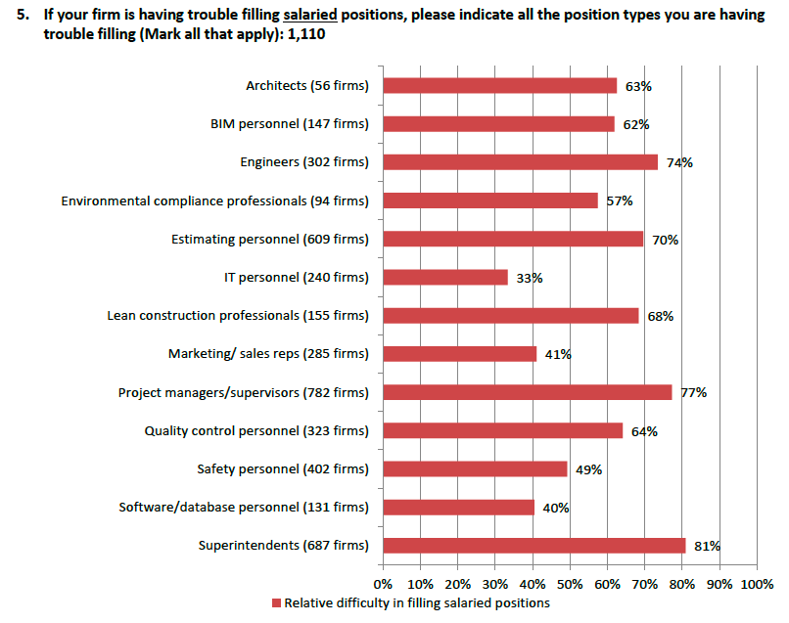
Superintendents are the hardest salaried positions for organizations to fill.
AGC | Autodesk Construction Cloud 2023 Workforce Survey

Slide 9
The Field Leader Shortage
High Demand
Increasing Demand
Short Supply
Decreasing Supply
81%
11%
34k
30%
In 2023, a survey of CEO’s reported 81% had difficulties finding field managers.
Outpacing the average for all occupations, field manager demand is expected to grow 11% between 2020 and 2030.
An estimated 34,000 construction superintendent positions remain unfilled in the U.S. in 2023.
As more and more construction craft professional reach retirement, field managers are expected to reach 30% turnover in the next five years.
In Q2 2022, 63% of CEOs surveyed by CIRT reported difficulty finding field managers and 29% reported high turnover in their field management staffs.

Slide 10
Previous generations of field leaders learned through on-site experience and may not have had formal training. That means that the knowledge passed on to up-and-coming leaders is limited. Now, with a shortage of experienced field leaders, people are being asked to lead or make decisions without the experience or supervision they may have had in the past. As we know, training helps with talent retention as well as the bottom line of a project. So, what can be done?
-Excerpt from FMI 2022 | Trading on Excellence: The Value of Talented Field Leaders

Slide 11
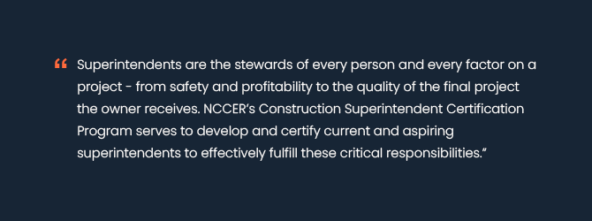
The Construction Superintendent Certification Program accelerates competency development that leads to:
+
Reduced Project Risk
Increased Project Profitability

Slide 12
Major Industry Support
Developed with support from 75 well-known industry leaders, including:
American Contractors Insurance Group
Archer Western Construction
Baker Construction Enterprises, Inc.
Bechtel Global
Brasfield & Gorrie
Cianbro
Clemson University
Construction Industry Institute (CII)
Construction Safety Research Alliance (CSRA) at the University of Colorado
Gilbane Building Company
Gray Construction
Haskell
Hensel Phelps
Irving Materials (IMI)
ISC Constructors, LLC
Jacobs
Kiewit/TIC
Linbeck Group
M.C. Dean
Marek
McCarthy Building Company
Procore
S&B Family of Companies
Shelby Erectors
Skanska USA Building, Inc.
Steel Erectors Association of America
Sundt Construction
Trimble, Inc.
Turner Industries
University of Florida
Yates Construction
Zachry Group
And more…

Slide 13
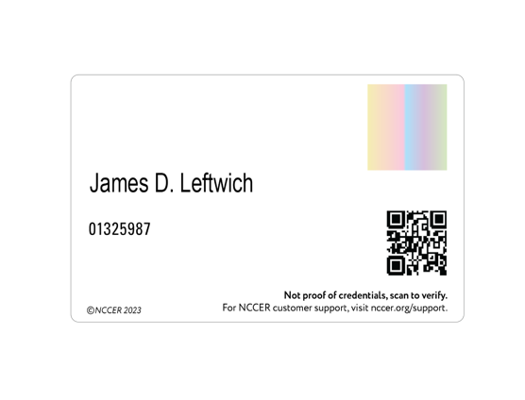
Robust program that builds a qualified and certified team of field leaders.
01
Online, self-paced training lets you keep your field leaders on the job
02
Practical and usable real-world examples and lessons taught by some of the nation's most seasoned construction superintendents​ and executives
03
Rigorous assessment of knowledge and verification of experience

Slide 18
There are two pathways to certification.
Construction Superintendent Certification Pathway:
Confirm Experience
Assess
Upskill
1
2
3
Construction Superintendent Development Pathway:
Train
Assess
Confirm Experience
1
2
3

Slide 19
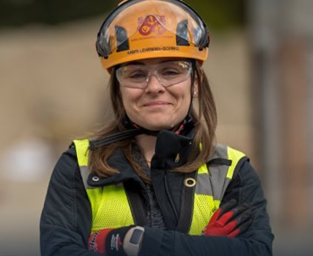
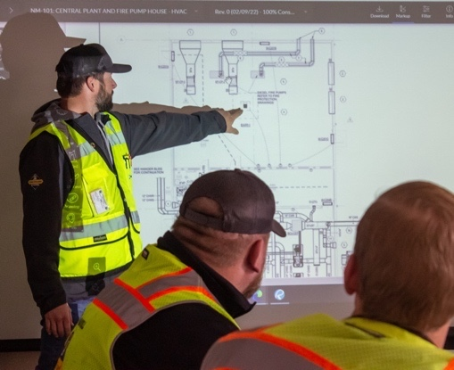
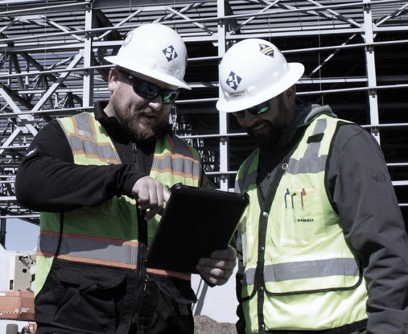
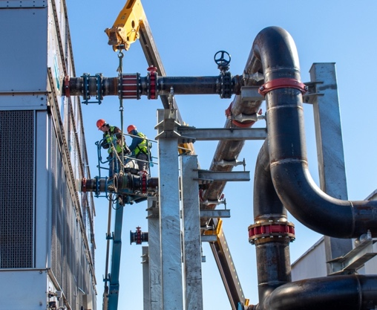
02
Shortening the learning curve and helping trainees grow into highly effective superintendents more quickly.
Ensuring relevancy and alignment with modern industry trends through input from industry leaders.
01
03
Equipping seasoned professionals with new strategies and knowledge for better results.
Building strong leaders through shared personal insight on leadership and communication from top construction executives.
Program delivery may be tailored to meet the specific needs of your team.

Slide 20
New Craft Training Model Assistance
Provided by NCCER:
Extensive portfolio of content (~2000 modules)
Instructional designers
Technical and script writers
Video team
Digital content developers
Delivery platform
What we need:
Access to project sites for video shoots
Subject matter experts (guidance and content review)
On screen talent

Slide 21
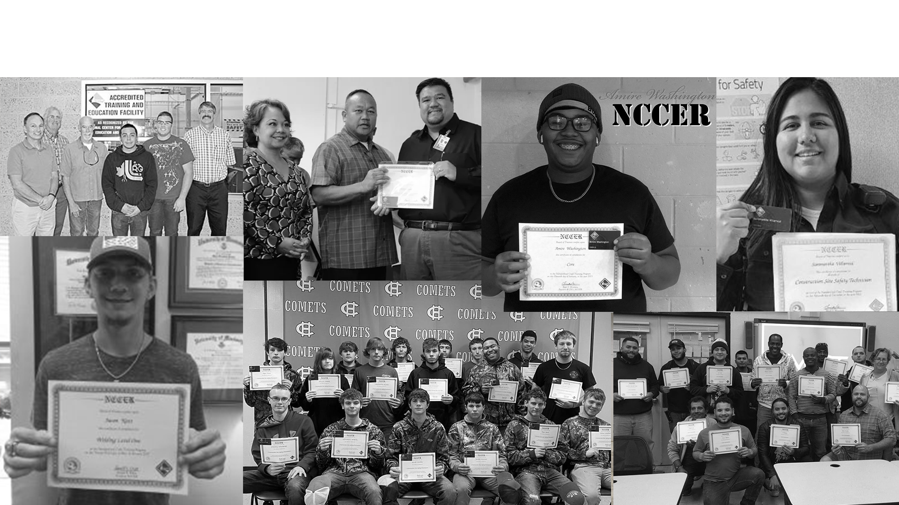
Changing lives since 1996 with help from companies like you.
Notes:
The commitment and vision from CEOs like you has changed the lives of over one million students.

Slide 22
Thank you!
For questions, please contact:
Boyd Worsham
bworsham@nccer.org
Jennifer Wilkerson
jwilkerson@nccer.org

